Slide 1
IOT-Phase-03 Submission
Objective:
Used to modify the noise level with a microphone sensor connected to pin 2 of your microcontroller.
Necessary modules: `Pin`, `ADC`, `sleep`, and `math`.
-> ADC (Analog to Digital Converter) for the microphone on Pin 2 with an attenuation of 11 dB, which helps in setting the measurement range.
-> Define a noise threshold level of 60 dB. If the measured sound level in dB exceeds this threshold, it will print a warning message.
-> Read the microphone level using `mic.read()`.
-> Calculate the sound level in decibels (dB) using a logarithmic function.
.

Slide 2
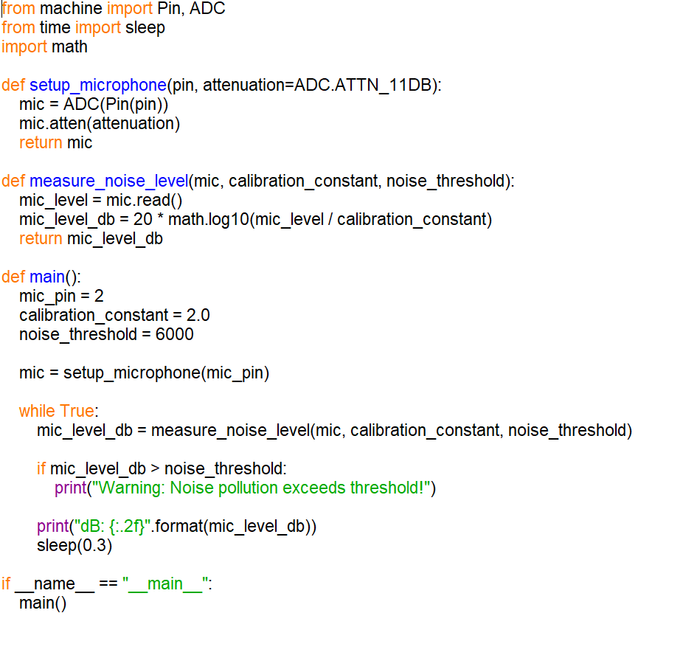
Python Code Sniphet:
Check if the sound level exceeds the noise threshold and print a warning if it does.
Sleep for 0.3 seconds before repeating the measurement.

Slide 3
{
"version": 1,
"author": "Gokul Raja",
"editor": "wokwi",
"parts": [
{
"type": "wokwi-esp32-devkit-v1",
"id": "esp",
"top": -129.7,
"left": 119.8,
"attrs": { "env": "micropython-20231005-v1.21.0" }
},
{ "type": "wokwi-microphone", "id": "mic", "top": -132.18, "left": 330.99, "attrs": {} }
],
"connections": [
[ "esp:TX0", "$serialMonitor:RX", "", [] ],
[ "esp:RX0", "$serialMonitor:TX", "", [] ],
[ "mic:1", "esp:D2", "green", [ "v0" ] ],
[ "mic:2", "esp:GND.1", "green", [ "v0" ] ]
],
"serialMonitor": {"display":"plotter"},
"dependencies": {}
}

Slide 4
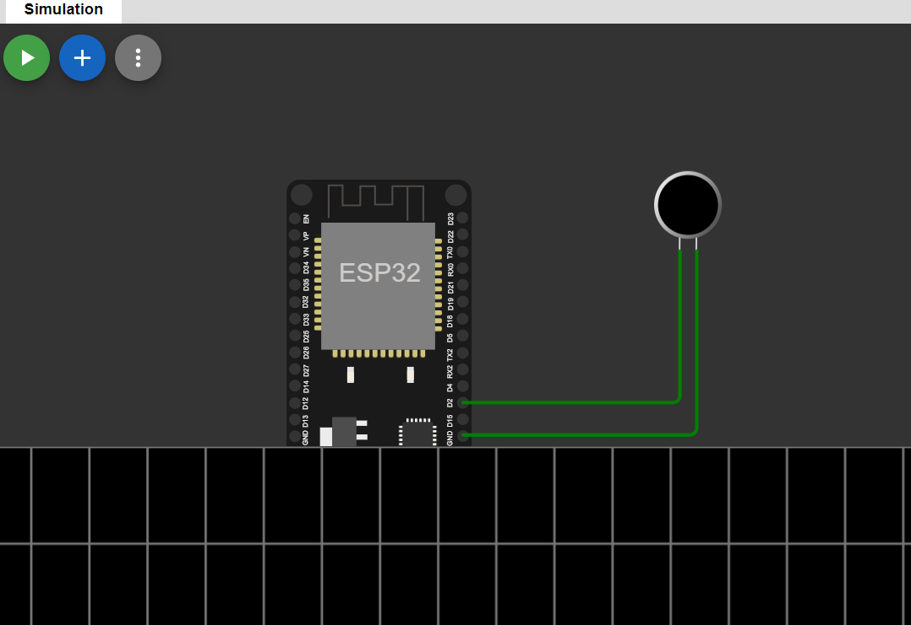
Output(Flow):

